Slide 1
CHAPTER 4: IMPERFECTIONS IN SOLIDS
ISSUES TO ADDRESS...
• What are the solidification mechanisms?
• What types of defects arise in solids?
• Can the number and type of defects be varied
and controlled?
• How do defects affect material properties?
• Are defects undesirable?

Slide 2
Imperfections in Solids
Many of the important properties of materials are due to the presence of imperfections, or defects. Anything that disrupts the symmetry of the material is by definition a defect. Defects in materials are not necessarily bad.
What are these imperfections?
Why are they important?

Slide 3
Types of Imperfections in Crystals
Vacancy atoms
Interstitial atoms
Substitutional atoms
Point defects
Dislocations
Line defects
Grain Boundaries
Surfaces
Area defects

Slide 4
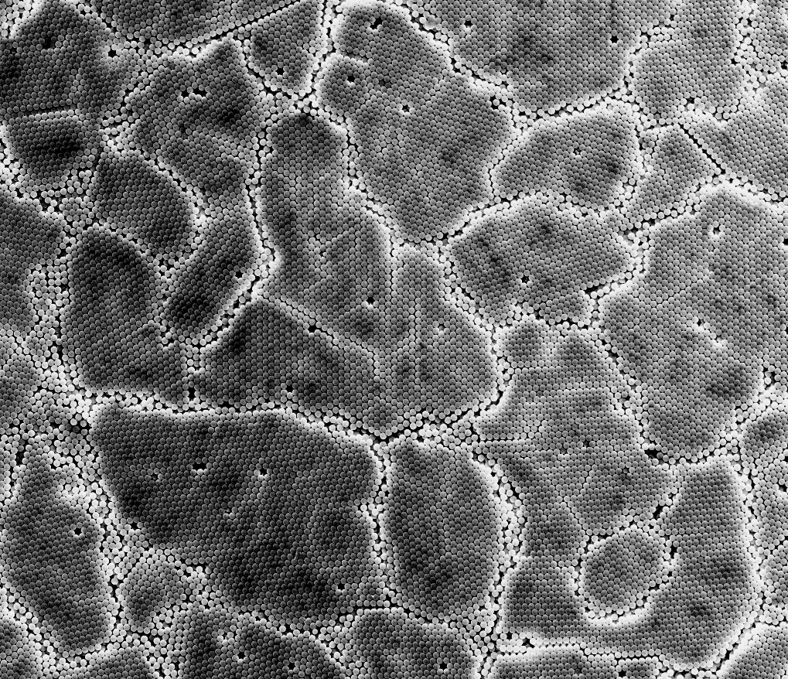

Slide 5
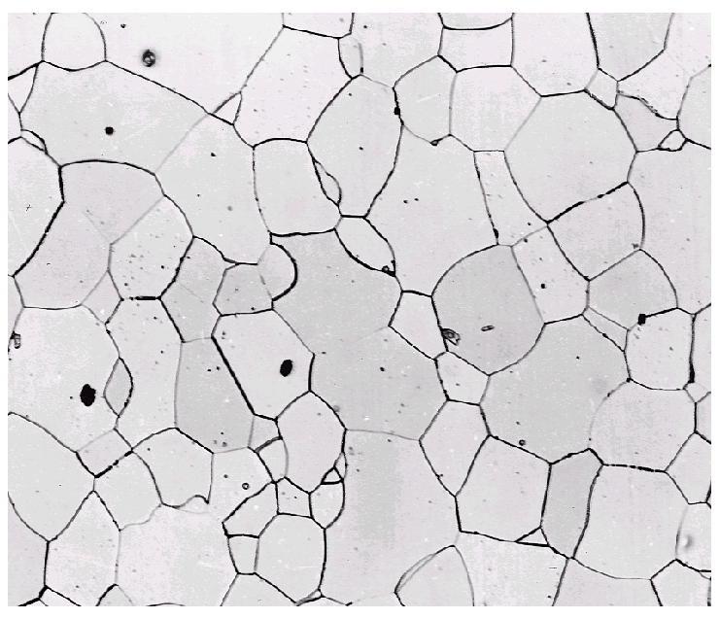

Imperfections in Solids
Solidification- result of casting of molten material
2 steps
Nuclei form
Nuclei grow to form crystals – grain structure
Start with a molten material – all liquid
nuclei
crystals growing
grain structure
liquid
Crystals grow until they meet each other

Slide 6
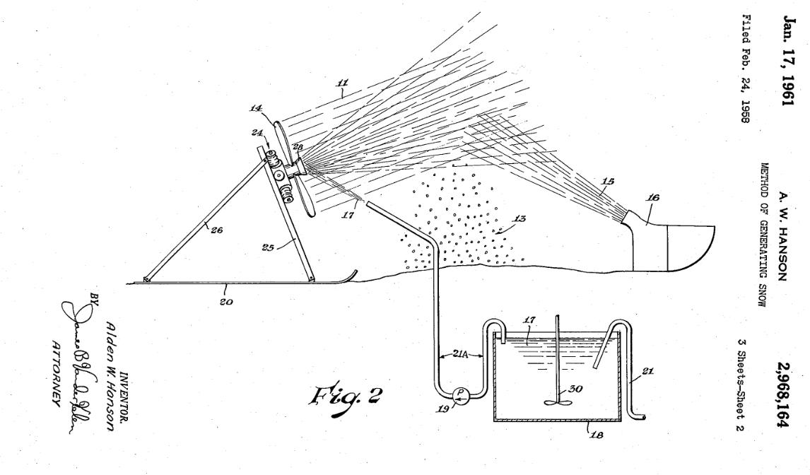
Nucleating Agents: Water -> Snow
“Surprisingly, the use of dirty water or water containing crushed ice results in more efficient operation, whereby the dirt and ice particles serve as crystallizing nuclei thereby aiding in the formation of snow crystals.”

Slide 7

Crystal Nucleating Agents

Slide 8
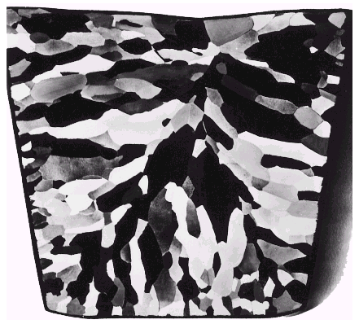
Solidification
Grains can be - equiaxed (roughly same size in all directions)
- columnar (elongated grains)
~ 8 cm
heat
flow
Shell of equiaxed grains due to rapid cooling (greater ΔT) near wall
Columnar in area with less undercooling
Grain refiner - added to make smaller, more uniform, equiaxed grains.

Slide 9
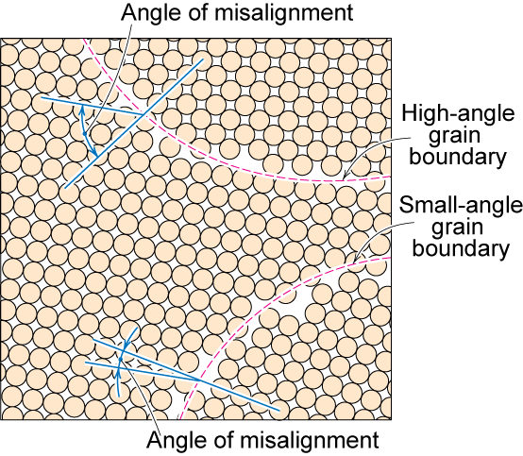
Polycrystalline Materials
Grain Boundaries
regions between crystals
transition from lattice of one region to that of the other
slightly disordered
low density in grain boundaries
high mobility
high diffusivity
high chemical reactivity

Slide 10
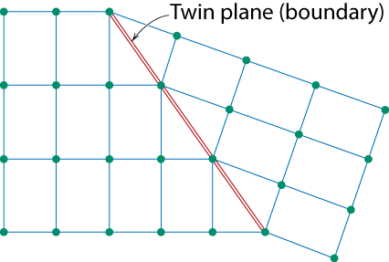
Planar Defects in Solids
One case is a twin boundary (plane)
Essentially a reflection of atom positions across the twin plane.
Stacking faults
For FCC metals an error in ABCABC packing sequence
Ex: ABCABABC

Slide 11
Point Defects

Slide 12
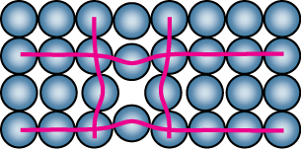
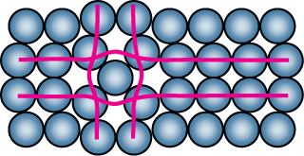
Point Defects
• Vacancies:
-vacant atomic sites in a structure.
Vacancy
distortion
of planes
• Self-Interstitials:
-"extra" atoms positioned between atomic sites.
self-
interstitial
distortion
of planes

Slide 13
Point Defects in Ionic Crystals

Slide 14
Importance of point defects
Solid-state diffusion (Chapter 5)
Mechanical properties (carbon in iron)
Electrical properties in semiconductors
Color
Al₂O₃: alumina, corundum (trigonal crystal structure)
+Chromium → ruby (red)
+Titanium, Iron,… → sapphire (not red: blue, orange, …)

Slide 15
Equilibrium Concentration: Point Defects
• Equilibrium concentration varies with temperature
No. of defects
Activation energy
⎛
−
⎞
N
v
⎜
Q
v
=
exp
⎜
No. of potential
⎝
⎠
N
k
T
defect sites.
Temperature
Boltzmann's constant
(1.38 x 10
-23
J/atom-K)
(8.62
x
10
-5
eV/atom-K)
Each lattice site
is a potential
vacancy site

Slide 16
Measuring Activation Energy
⎛
−
⎞
• We can get Q_{v} from
an experiment.
N
v
⎜
Q
v
=
exp
⎜
N
⎝
k
T
⎠
• Measure this...
• Replot it...
N
v
N
slope
v
ln
N
N
-
Q
v
/k
exponential
dependence!
T
1/
T
defect concentration

Slide 17
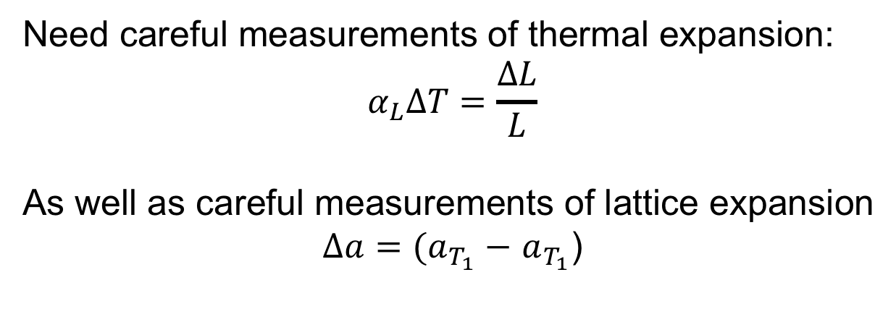
Q: how is N_{v} actually measured?
Need careful measurements of thermal expansion:
$$α_{L}ΔT=\frac{ΔL}{L}$$
As well as careful measurements of lattice expansion
$∆a=(a_{T_{1}}−$ $a_{T_{1}}$)
(dilatometry)
(X-ray diffraction)
Effect is small (Nv low relative to N), so experiments
require accuracy of 1/100,000, must be done at same time
Simmons and Balluffi, Phys. Rev., 117, 52, (1960).

Slide 18
Estimating Vacancy Concentration
• Find the equil. # of vacancies in 1 m³ of Cu at 1000°C.
• Given:
ρ
= 8.4 g
/
cm
3
A
= 63.5 g/mol
Cu
Q
v
= 0.9 eV/atom
N
A
= 6.02 x 10²³
atoms/mol
0.9 eV/atom
⎛
−
⎞
N
v
⎜
Q
v
=
exp
⎜
= 2.7 x 10⁻⁴
N
⎝
k
T
⎠
1273K
8.62 x 10⁻⁵
eV/atom-K
N
A
For 1 m³
, N =
ρ
x
x
1 m³
= 8.0 x 10²⁸ sites
A
Cu
• Answer:
N
v
=
(2.7 x 10⁻⁴)(8.0 x 10²⁸) sites = 2.2 x 10²⁵ vacancies

Slide 19
Point Defects in Alloys
Two outcomes if impurity (B) added to host (A):
• Solid solution of B in A (i.e., random dist. of point defects)
OR
Substitutional solid soln.
(e.g., Cu in Ni)
Interstitial solid soln.
(e.g., C in Fe)
• Solid solution of B in A plus particles of a new
phase (usually for a larger amount of B)
Second phase particle
--different composition
--often different structure.

Slide 20
Imperfections in Solids
Specification of composition
weight percent
m₁ = mass of component 1
atom percent
n_{m1} = number of moles of component 1
volume percent
V_{m1} = volume of component 1 = m₁/ρ₁

Slide 21
Line Defects
Dislocations:
• are line defects,
• slip between crystal planes result when dislocations move,
• produce permanent (plastic) deformation.
Schematic of Zinc (HCP):
• before deformation
• after tensile elongation
slip steps

Slide 22
Imperfections in Solids
Linear Defects (Dislocations)
Are one-dimensional defects around which atoms are misaligned
Edge dislocation:
extra half-plane of atoms inserted in a crystal structure
b ⊥ to dislocation line
Screw dislocation:
spiral planar ramp resulting from shear deformation
b || to dislocation line
Burger’s vector, b: measure of lattice distortion

Slide 23
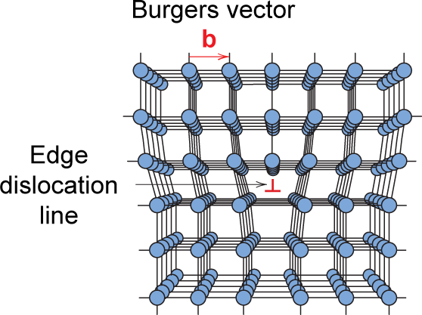
Imperfections in Solids
Edge Dislocation

Slide 24
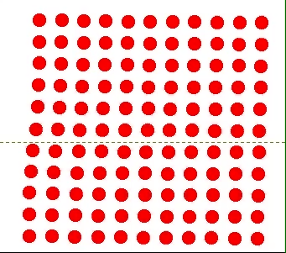
Motion of Edge Dislocation
• Dislocation motion requires the successive bumping
of a half plane of atoms (from left to right here).
• Bonds across the slipping planes are broken and
remade in succession.
Atomic view of edge
dislocation motion from
left to right as a crystal
is sheared.

Slide 25
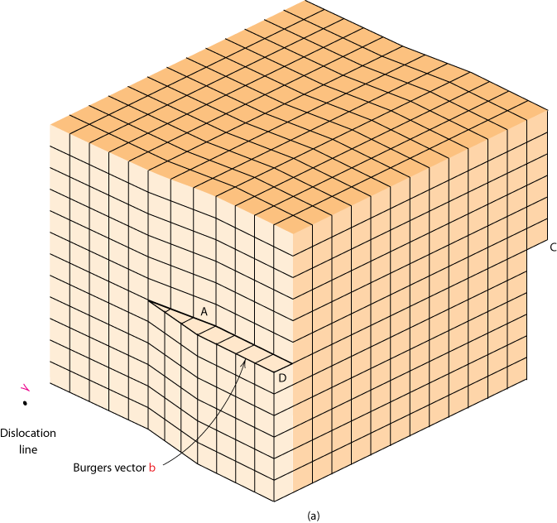
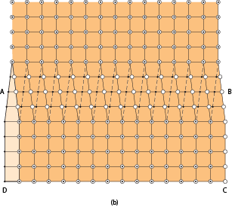
Imperfections in Solids
Screw Dislocation
Screw Dislocation
Dislocation
line
b
Burgers vector b
(b)
(a)

Slide 26
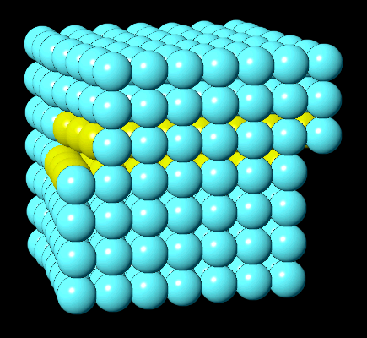
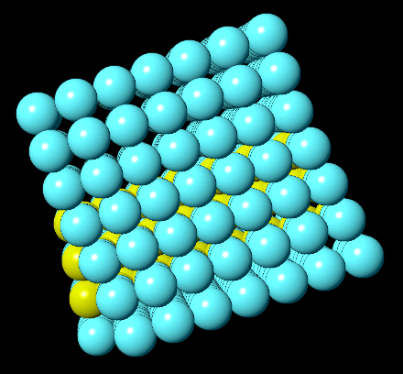
Screw Dislocation
In VMSE on wileyplus:
a region of crystal containing a dislocation can be rotated in 3D
dislocation motion may be animated
Front View
Top View
VMSE Screen Shots

Slide 27
Edge, Screw, and Mixed Dislocations
Mixed
Edge
Screw

Slide 28
https://youtu.be/JPVS8d2c_4U
Screw Dislocation Motion in CaO
Paulo Branicio, USC
Dislocations can
dissociate into
two partials and
a stacking fault
Needle in particles:
https://youtu.be/VLsLS74AM9o
Bragg, 1947, bubbles:
https://youtu.be/1r-UqxmuYCw

Slide 29
Why dissociate into partials?
Dislocation energy is proportional to Gb²
Full dislocation → Two partials + stacking fault
Gb² → G(b/2)² + γf + G(b/2)²
If equal, f = Gb²/2γ or γ = Gb²/2f
If γ small, partials will separate widely (f large)

Slide 30
Surface Energy
Some values of surface energy: mN/m or dyn/cm
Substance | Surface tension
Hexane | 18.4
Ethanol | 22.3
Acetic acid | 27.6
Water | 72
Mercury | 487
Carbon | 3700
Hexane

Slide 32
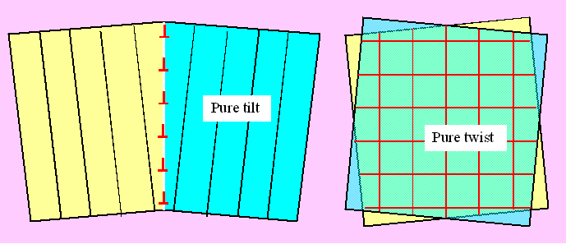
Low angle gbs: dislocation arrays

Slide 33
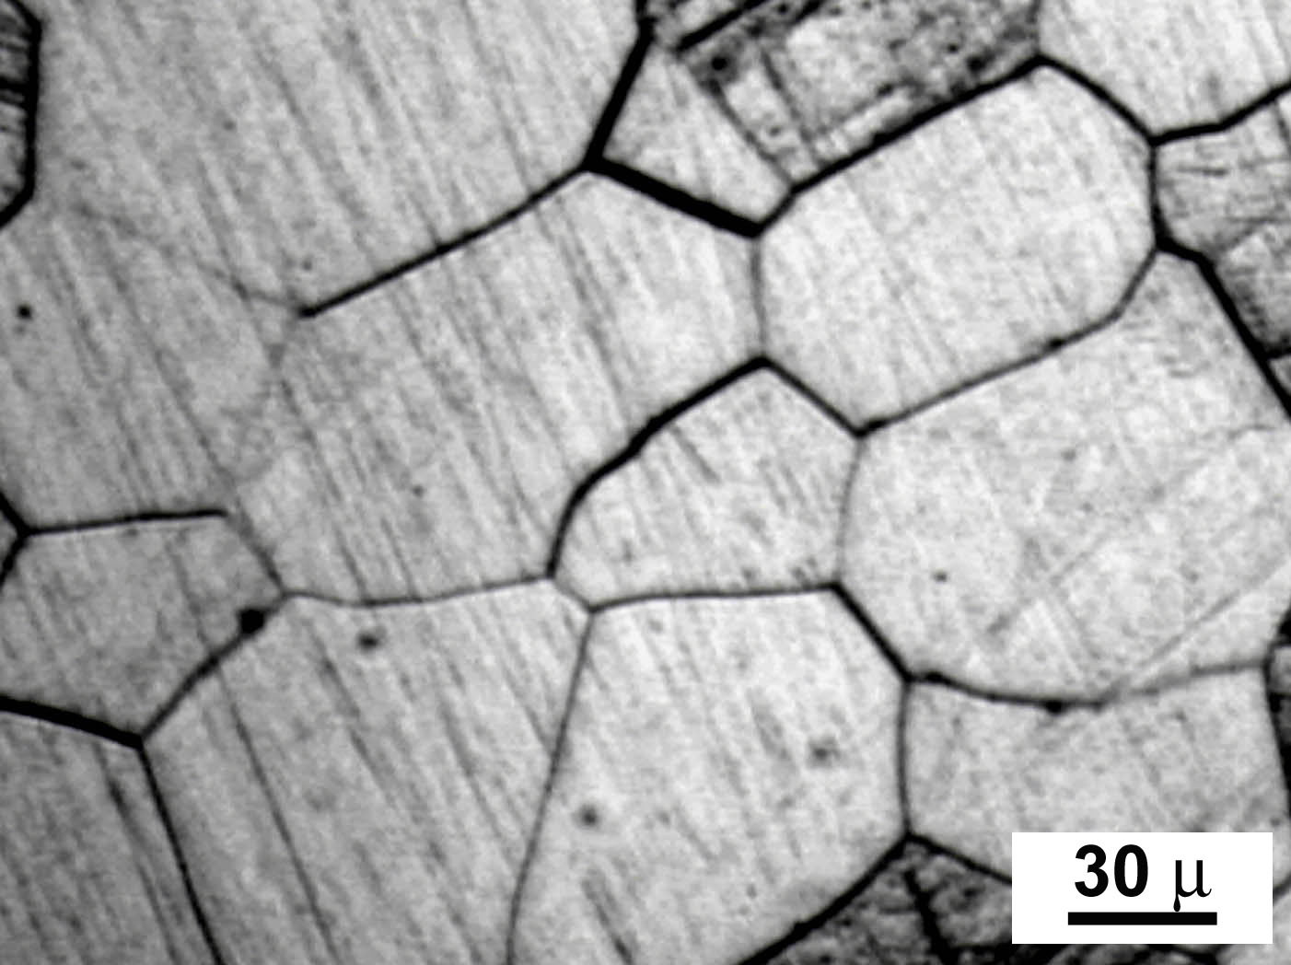
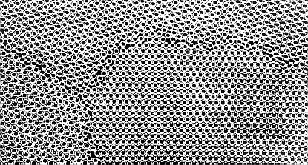
Grain Boundaries

Slide 34
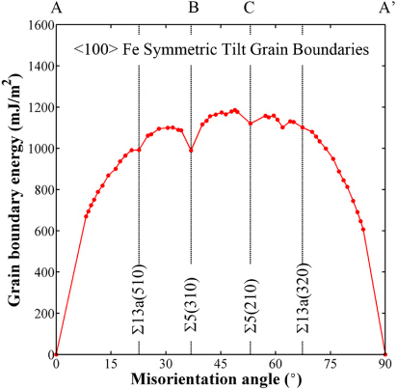
Grain boundary energies

Slide 35
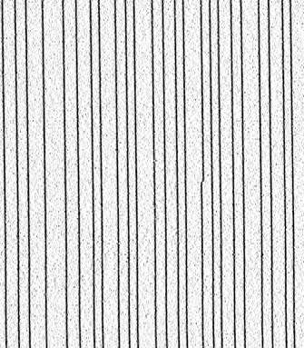
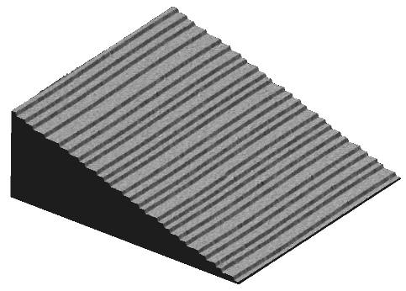
Steps and Kinks

Slide 36
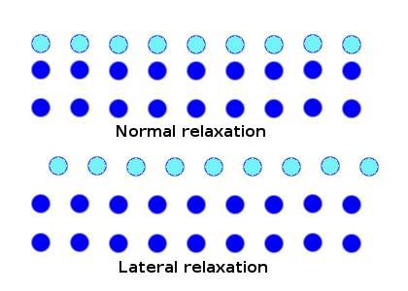
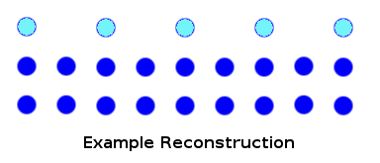
Surface reconstructions

Slide 37
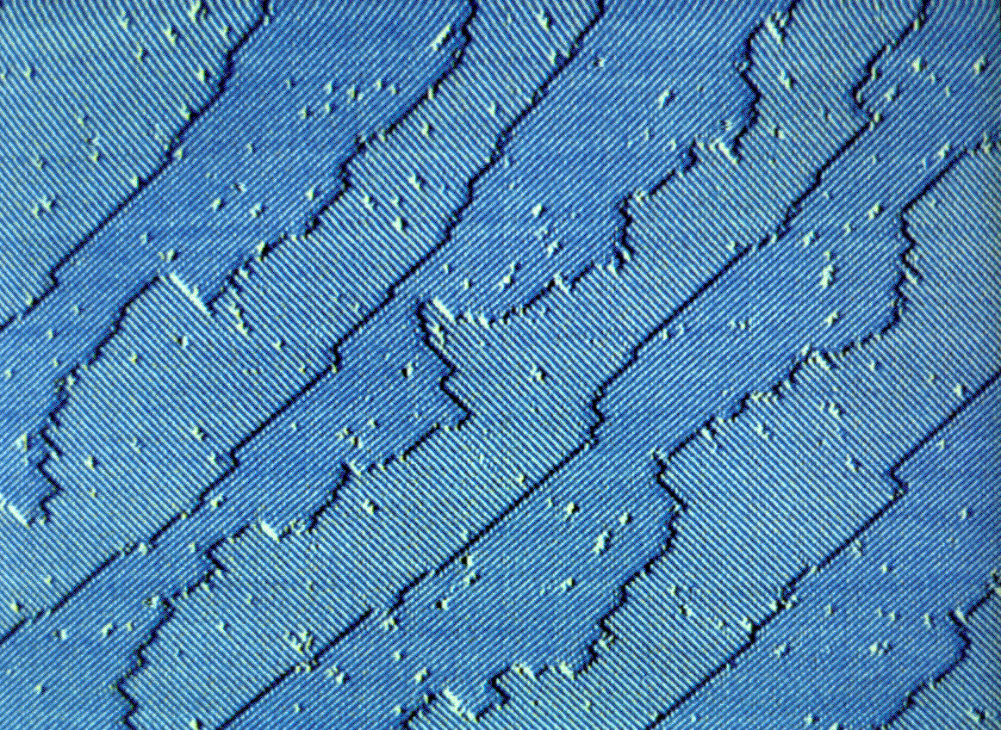
Si (001)

Slide 38
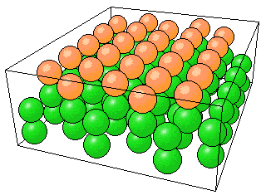
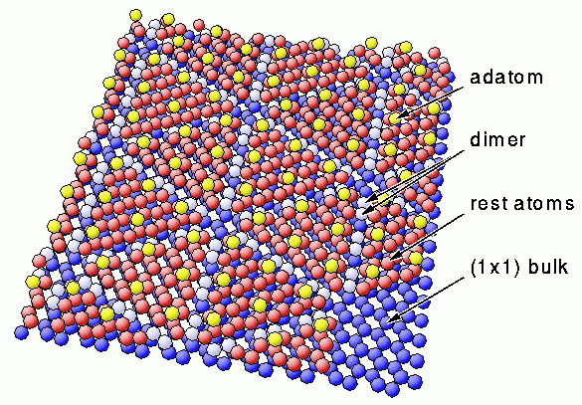
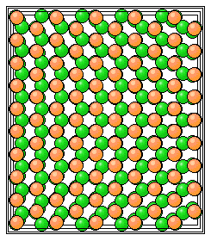
Si (111) 7x7 reconstruction

Slide 39
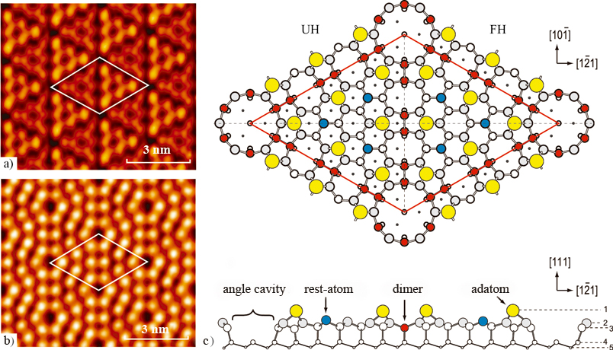
Si (111) 7x7 reconstruction

Slide 40
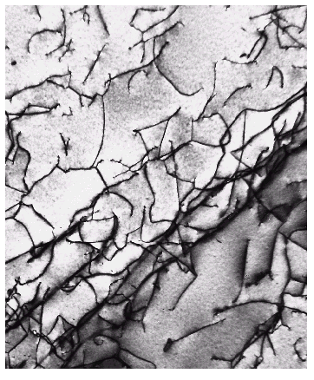
Imperfections in Solids
Dislocations are visible in electron micrographs: TEM
Looking down on
the top of a thin
metal film
Dislocations are the
dark lines, running
mostly from top to
bottom of the film

Slide 41
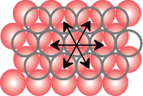
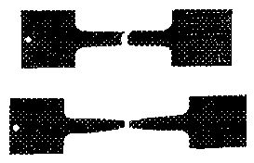
Dislocations, Slip Planes, & Crystal Structures
• Structure: close-packed
planes & directions
are preferred.
view onto two
close-packed
planes.
close-packed directions
close-packed plane (bottom)
close-packed plane (top)
• Comparison among crystal structures:
FCC: many close-packed planes (111)/directions [110];
HCP: only one (basal) plane, 3 directions;
BCC: none
• Specimens that
were tensile
tested.
Mg (HCP)
tensile direction
Al (FCC)

Slide 42
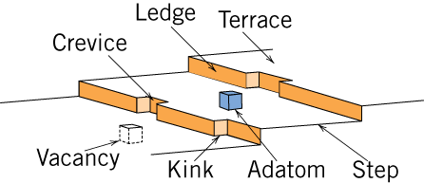
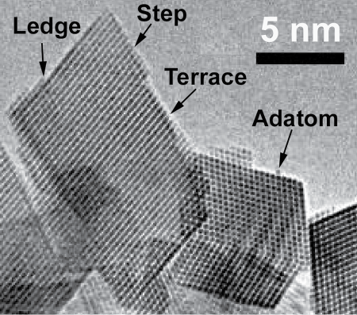
Catalysts and Surface Defects
A catalyst increases the rate of a chemical reaction without being consumed
Active sites on catalysts are normally surface defects
Fig. 4.11, Callister & Rethwisch 9e.
Single crystals of (Ce_{0.5}Zr_{0.5})O₂ used in an automotive catalytic converter
Fig. 4.12, Callister & Rethwisch 9e.
[From W. J. Stark, L. Mädler, M. Maciejewski, S. E. Pratsinis, and A. Baiker, “Flame Synthesis of Nanocrystalline Ceria/Zirconia: Effect of Carrier Liquid,” Chem. Comm., 588–589 (2003). Reproduced by permission of The Royal Society of Chemistry.]

Slide 44
Changing grain size: additives (refiners)
Left: pure aluminum. Right: +0.2% Al-5Ti-1B refiner

Slide 45
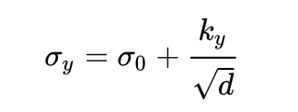
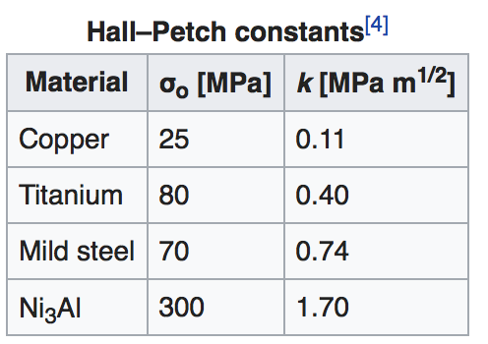
Effects on properties: Yield Stress
Grain boundaries cause dislocation pile-up
Hall-Petch equation
For larger grains, metals
get harder when grain size d
gets smaller

Slide 46
When grains are really small (~10 nm) the material softens (g.b. sliding?)
FCC Copper
Xiao et al., (2015): DOI: 10.1098/rspa.2014.0832

Slide 47
Small amounts of impurities (dopants) added to crystalline, semiconducting silicon dramatically changes electrical properties
p-doping
holes
n-doping:
electrons

Slide 48
Field-Effect Transistor
A small voltage
change on the gate
dramatically changes
current flow from
source to drain
Electronic valve:
can be open, closed
Can be used as
an amplifier, logic gate,
memory

Slide 49
Understanding Defects: Microscopic Examination
Crystallites (grains) and grain boundaries. Vary considerably in size. Can be quite large
ex: Large single crystal of quartz or diamond or Si
ex: Aluminum light post or garbage can - see the individual grains
Crystallites (grains) can be quite small (mm or less) – necessary to observe with a microscope.

Slide 50
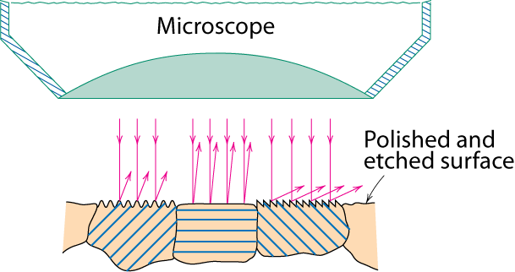
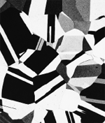
Optical Microscopy
• Useful up to 2000X magnification (~1 μm).
• Polishing removes surface features (e.g., scratches)
• Etching changes reflectance, depending on crystal
orientation.
crystallographic planes
Micrograph of
brass (a Cu-Zn alloy)
0.75mm

Slide 51
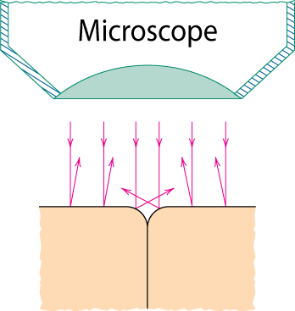
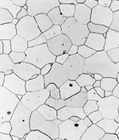
Optical Microscopy
Grain boundaries...
• are imperfections,
• are more susceptible
to etching,
• may be revealed as
dark lines,
• change in crystal
orientation across
boundary.
polished surface
surface groove
grain boundary
(a)
ASTM grain
size number
n
= 2
G
-1
Fe-Cr alloy
number of grains/in²
at 100x
(b)
magnification

Slide 52
ASTM E 112-13
Standard for Determining Average Grain Size
Image analysis software: ImageJ from NIH

Slide 54
Optical Microscopy
Polarized light
metallographic scopes often use polarized light to increase contrast
Also used for transparent samples such as polymers

Slide 55
Microscopy
Optical resolution ca. 10⁻⁶ m = 1 μm = 1000 nm
Wavelength of visible light: 400-700 nm
For higher resolution need small wavelengths
X-Rays? Wavelength: Cu Kα 0.154 nm (1.54 Ang)
Difficult to focus, scattering OK
Electrons
Electron beam focused by magnetic lenses
Voltages 5 kV : 100-400 kV : 1 MV
Wavelengths ~ 3 pm (0.003 nm)
Magnifications - 1,000,000X
Atomic resolution possible… approaching 0.05 nm (0.5 Ang)
Scanning EM (SEM): 1 kV – 30 kV
Transmission EM (TEM) : 200-400 kV
STEM
Notes:
Optical microscopy good to ca. wavelength of light
Higher frequencies
X-rays – good idea but difficult to focus
Electrons - wavelength proportional to velocity with high voltage (high acceleration) get wavelengths ca. 3pm (0.003nm) (x1,000,000)

Slide 56

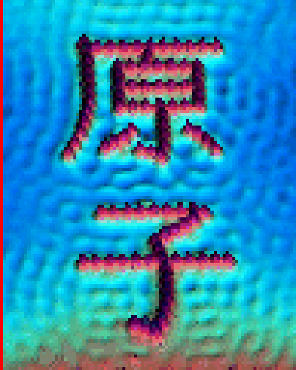
Scanned Probe Microscopies: Scanning Tunneling Microscopy (STM) Atomic Force Microscopy (AFM)
• Atoms can be arranged and imaged!
Iron atoms arranged on a copper (111) surface. These Kanji characters represent the word “atom”.
Carbon monoxide molecules arranged on a platinum (111) surface.

Slide 57
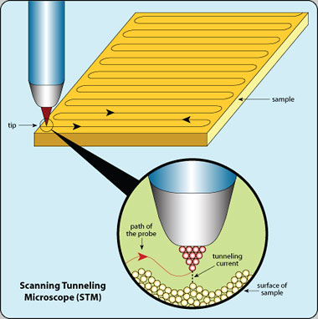
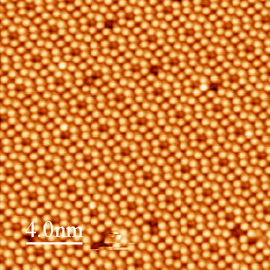
http://www.nisenet.org/publicbeta/articles/seeing_atoms/index.html
http://www.princeton.edu/~kahnlab/STMImages.

Slide 58


Slide 59
Zeiss Auriga 60 FIB/SEM
JEOL JSM-7400F SEM
FEI / ThermoSci Talos 200C STEM
JEOL JEM-3010 TEM
JEOL JEM-2010F STEM
FEI / ThermoSci Technai G2 12 TEM

Slide 60
https://www.quora.com/What-is-the-difference-between-the-SEM-microscope-and-the-STEM-microscope

Slide 61


Slide 62
X-ray Diffraction
Thermal Analysis
Porosity and Particle Size Analysis
Vibrational Spectroscopy
Mass Spectroscopy
http://sites.udel.edu/amcl/

Slide 63
Summary
• Point, Line, and Area defects exist in solids.
• The number and type of defects can be varied
and controlled (e.g., T controls vacancy conc.)
• Defects affect material properties (e.g., grain
boundaries control crystal slip).
• Defects may be desirable or undesirable
(e.g., dislocations may be good or bad, depending
on whether plastic deformation is desirable or not)

Slide 64
Imperfections in Solids
Conditions for substitutional solid solution (S.S.)
W. Hume – Rothery rules
1. Δr (atomic radius) < 15%
2. Proximity in periodic table
i.e., similar electronegativities
3. Same crystal structure for pure metals
4. Valency
All else being equal, a metal will have a greater tendency to dissolve a metal of higher valency than one of lower valency

Slide 65
Imperfections in Solids
Application of Hume–Rothery rules – Solid Solutions
1. Would you predict more Al or Ag to dissolve in Zn?
2. More Zn or Al
in Cu?
Element Atomic Crystal Electro- Valence Radius Structure nega- (nm) tivity
Cu 0.1278 FCC 1.9 +2 C 0.071 H 0.046 O 0.060 Ag 0.1445 FCC 1.9 +1 Al 0.1431 FCC 1.5 +3 Co 0.1253 HCP 1.8 +2 Cr 0.1249 BCC 1.6 +3 Fe 0.1241 BCC 1.8 +2 Ni 0.1246 FCC 1.8 +2 Pd 0.1376 FCC 2.2 +2 Zn 0.1332 HCP 1.6 +2

